Slide 1
Real-Time Crowd Flow Monitoring & Heatmap Analysis Using Nx Toolkit
Ideathon Submission for Nx Venue Innovation Hackathon
Team Name: Heat Map mavericks
Team Members: Mohamed Salik S (Machine Learning Developer)
Mohamed Farhun M (Video processing and prediction specialist)
Venkatesan J (GenAI developer)

Slide 2
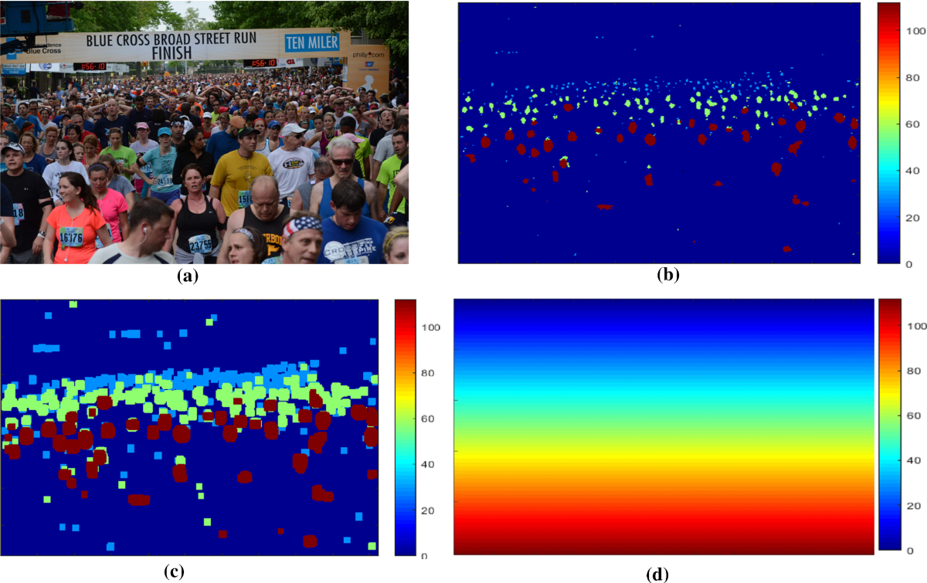
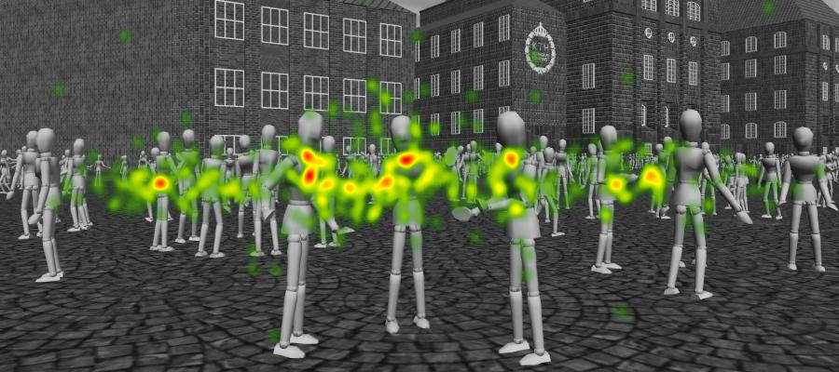
PROBLEM STATEMENT
Context: Large venues face crowd congestion, inefficient visitor navigation, and potential safety issues due to limited
real-time monitoring.
Key Challenge: Lack of visibility into crowd flow and bottlenecks. Delayed reaction times when crowd
Surges occur.
Opportunity: Use AI-driven heatmaps and alerts to provide actionable insights that enhance visitor experience
and venue safety.

Slide 3

Approach (User Interaction)
User Access: Nx Client (desktop) or Mobile App.
Features:
Live Camera Feeds: Venue managers view real-time video overlaid with crowd density indicators.
Heatmaps & Alerts: Interactive heatmaps highlight congestion zones; automated alerts prompt
quick action.
Historical Analysis: Trend charts for evaluating foot traffic over time.
Sample Wireframe:
Main Dashboard → color-coded (density zones) → Alert pops for threshold breaches
For ex: Section B ( A particular area is over capacity)

Slide 4

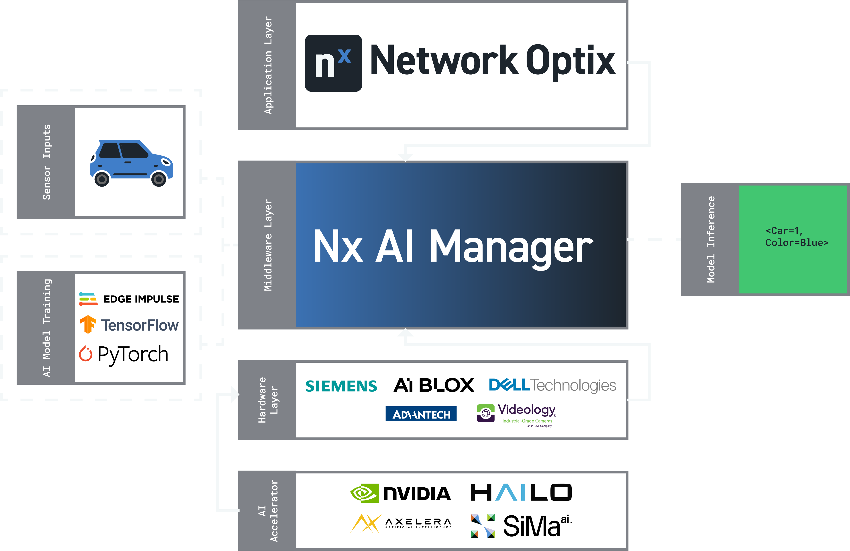
Approach (Technical Solution)
Data Ingestion: IP cameras or CCTV feeds from strategic crowd vantage points.
AI/ML Pipeline:
Object Detection: Person/crowd detection via Nx AI Manager plugin.
Tracking & Analytics: Real-time tracking computes dwell time and crowd flow.
Heatmap Generation: Overlays processed data on a venue floor plan.
Business Rules:
Trigger alerts at user-defined thresholds to address congestion promptly.

Slide 5
System diagram
start
Cameras
Nx AI Manager
Tracking and
Analysis
Nx client/Mobile
End

Slide 6
NX INtegration
Nx AI Manager Plugin:-
Role: Hosts and executes detection/tracking models for real-time crowd analysis.
Nx Model Manager:-
Role: Load, configure, and switch between pretrained models (e.g., YOLO-based crowd counting).
Nx Pipeline Configurator:-
Role: Define the entire flow (camera input →inference →post-processing→ output).
Post-Processing / Business Rules:-
Role: Applies threshold-based logic to generate alerts or recommended actions.
Nx Toolkit APIs:-
Role: Enables metadata extraction (bounding boxes, counts) and overlays heatmaps on the Nx Client UI.

Slide 7
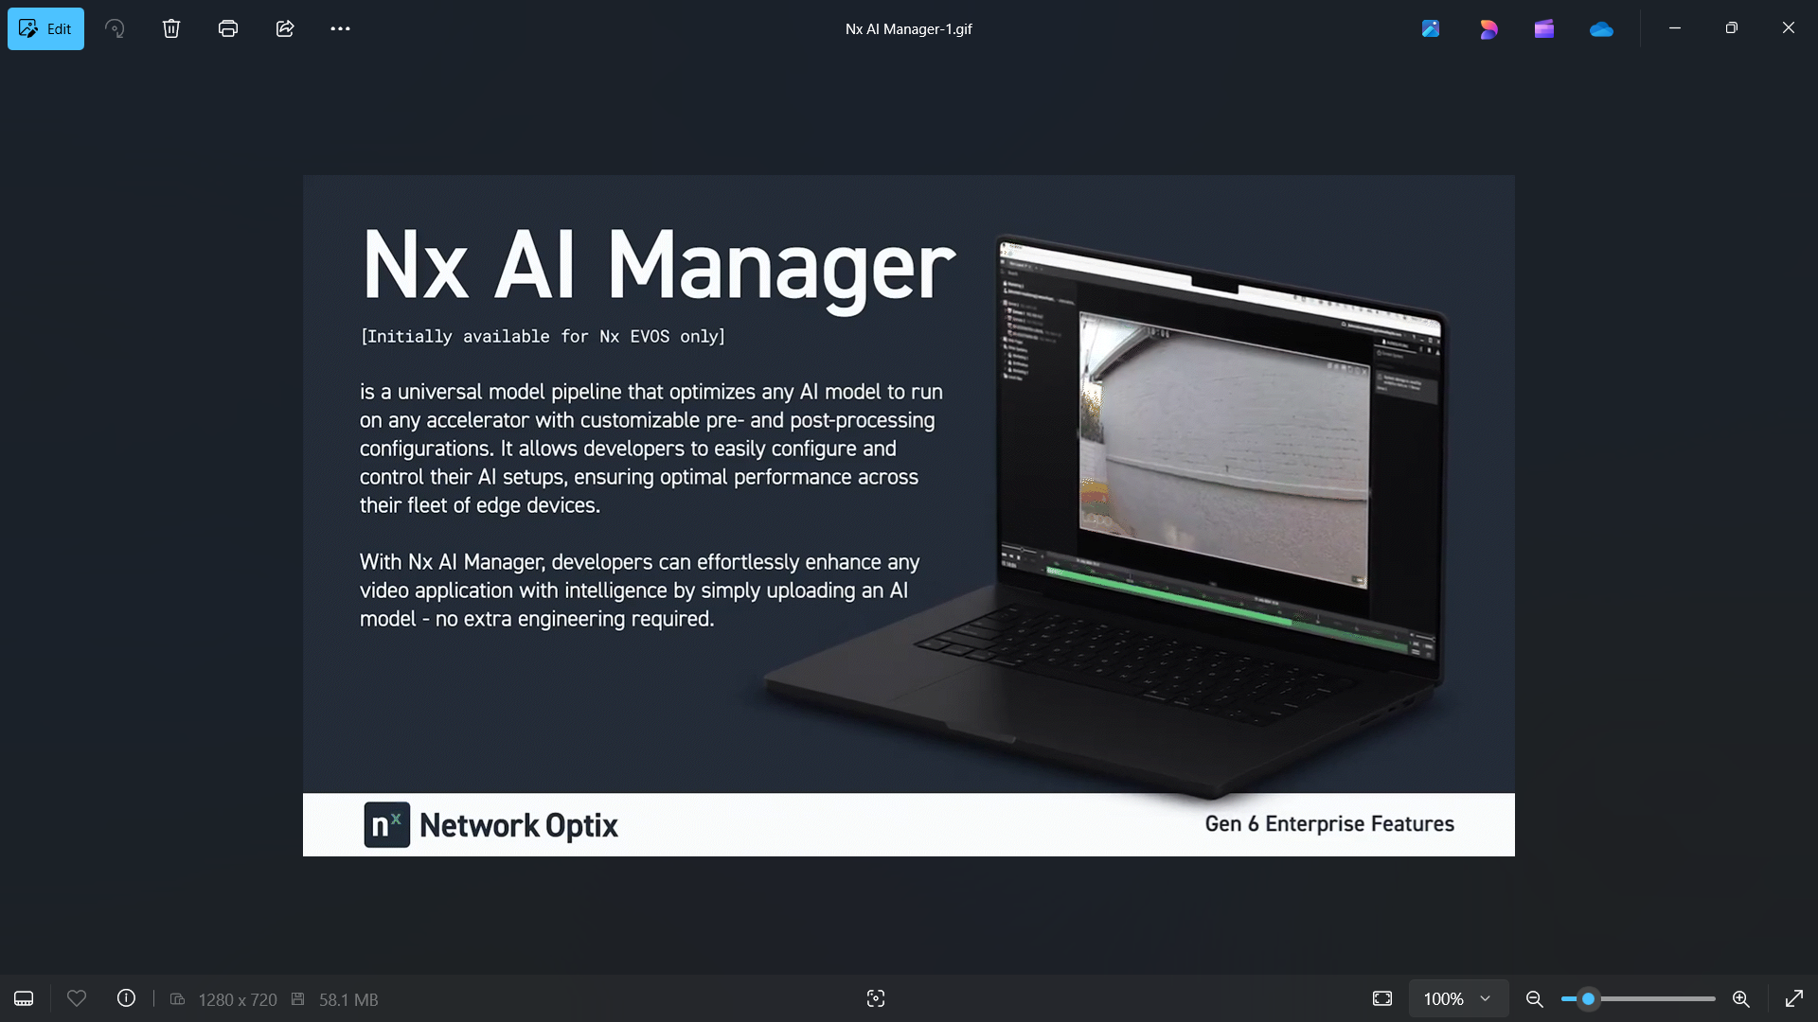
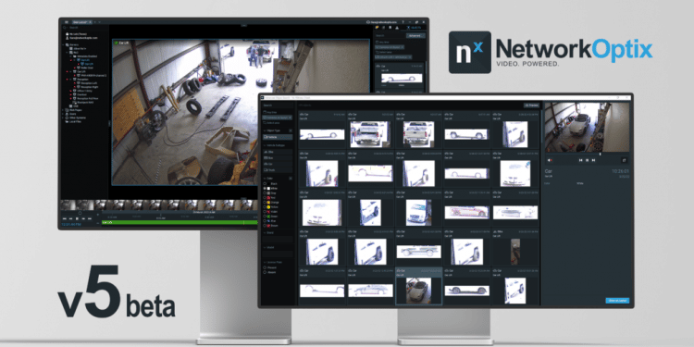
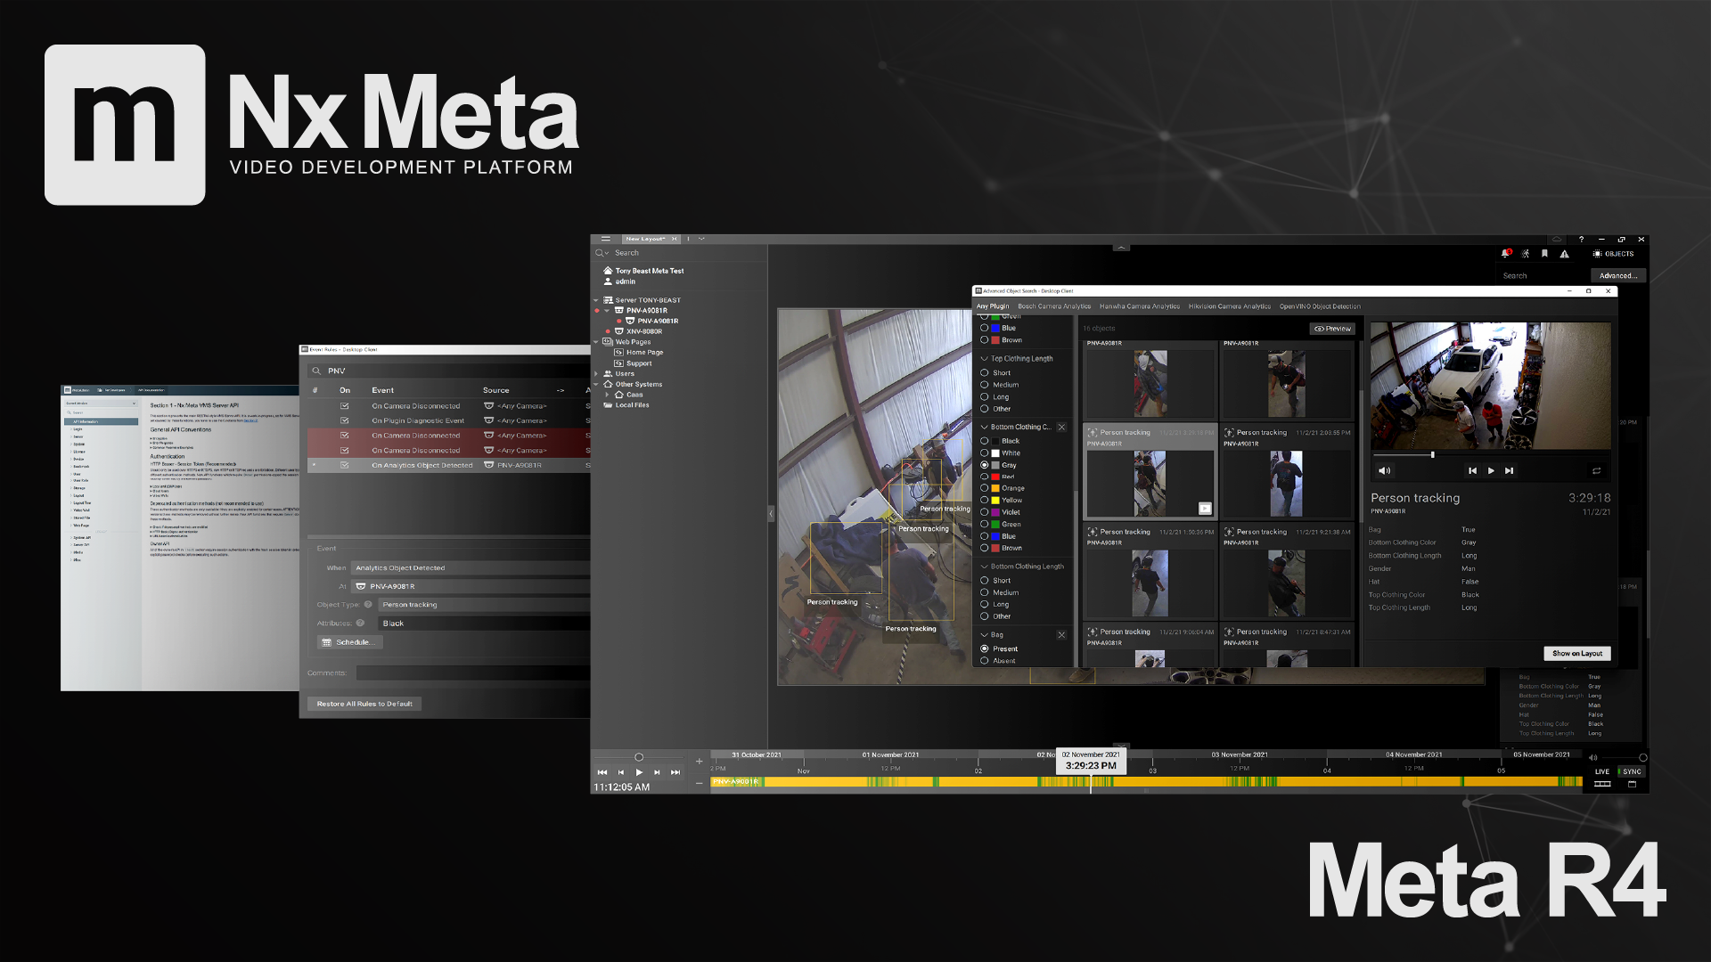
NX INtegration
Nx Metadata Injection:-
Role: Visual overlays for bounding boxes and heatmaps on live streams.

Slide 8

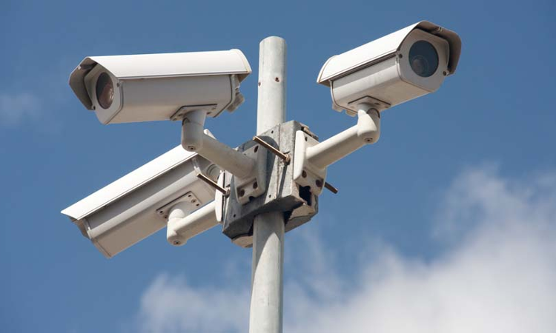
Hardware & Deployment
Edge Device / Nx Server:
Approach: Smaller venues can run the plugin on edge devices (low latency).Larger venues utilize robust Nx servers for centralized analysis.
Camera Requirements:
Minimum 720p streaming for accurate crowd detection.
Wide-angle lenses to maximize coverage in congested areas.

Slide 9
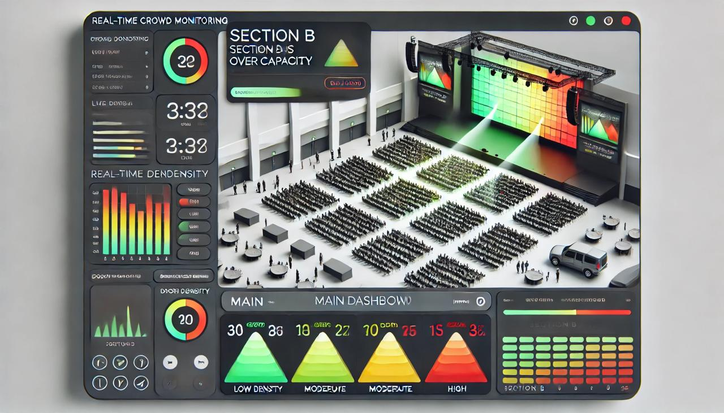
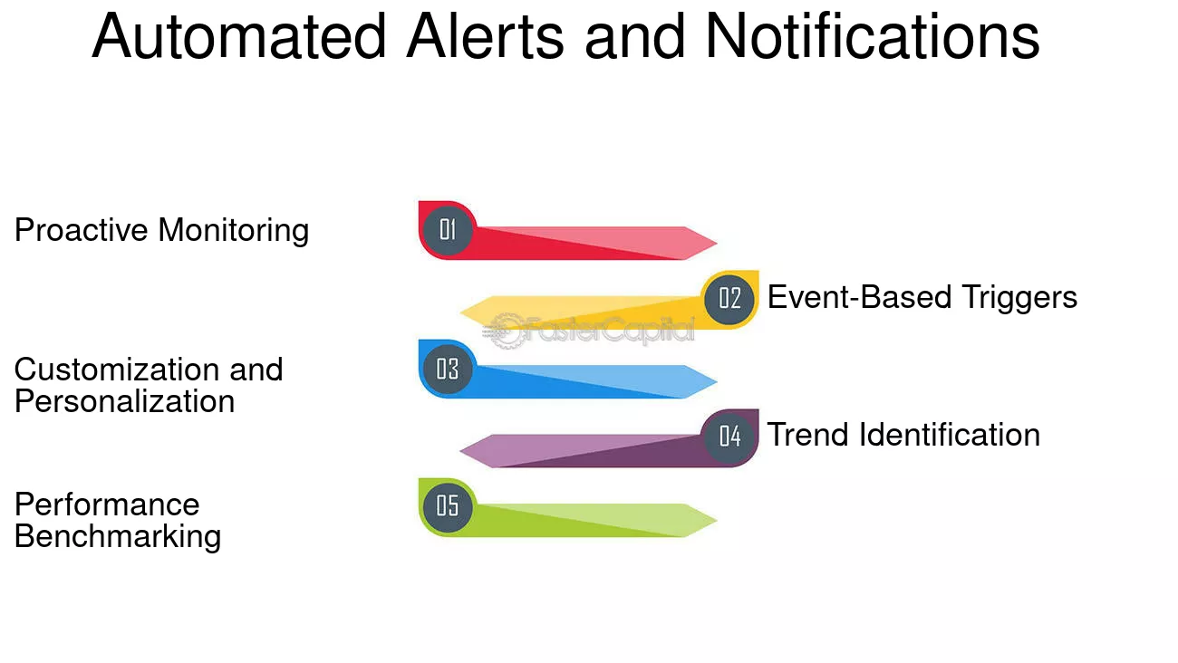
Visual representation
System Architecture Diagram:
Showcase camera
Nx AI Manager
Nx Toolkit
Crowd color coded densities
Nx client

Slide 10
Innovation & Impact
Uniqueness:
Real-time AI-driven detection, tracking, and heatmap generation in a single integrated Nx solution.
Simplifies configuration and maintenance versus multi-vendor systems.
Potential Impact:
Safety: Early detection and resolution of overcrowding.
Visitor Experience: Dynamic navigation routes reduce wait times.
Operational Efficiency: Data-driven insights inform layout changes or staffing decisions.

Slide 11
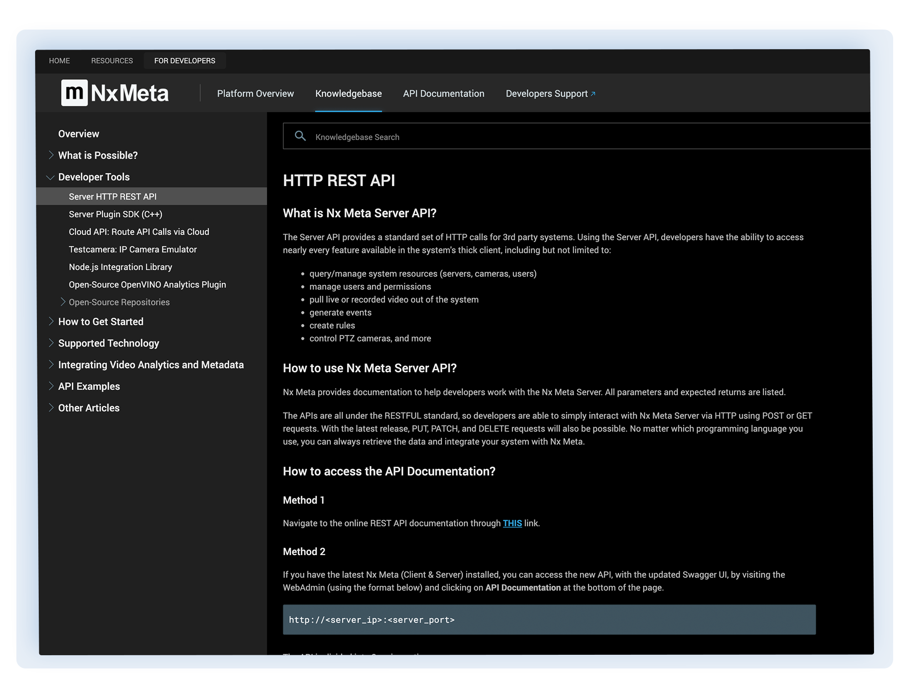
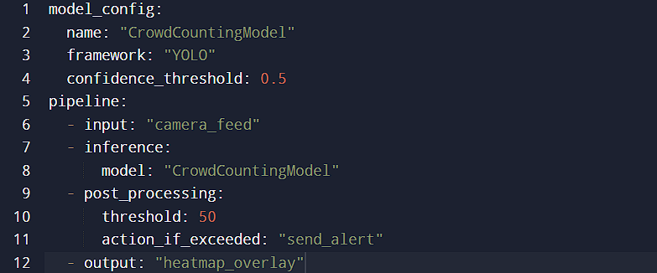
Snippet of nx toolkit usage
Code snippet
Nx rest API usage

Slide 12
CONCLUSION / NEXT STEPS
Our solution provides real-time crowd flow monitoring and heatmap analysis to enhance venue safety and visitor experience.
By integrating with Nx Toolkit, it offers a scalable and user-friendly platform for managing congestion and ensuring operational efficiency.
Next Steps:
Predictive Modeling: Develop analytics to forecast crowd movements.
IoT Integration: Enable dynamic navigation and automated crowd control measures.
Contact: mohd.salik16@gmail.com
Resources used:Nx meta documentation,
Nx developer docs

